Slide 1

Benha University
Faculty of computers And Artificial Intelligence
(BFCAI)
Brain Tumor Segmentation
Team Name
Ahmed Emad Nour
Abdel Moneim Elsayed Abdel Moneim
Ahmed Ayman Fathi Salama
Supervisor:
Prof/ Hala Zayed
Eng. Nada Baha

Slide 2
Project Introduction
Brain tumors affect the humans badly, due to the abnormal growth of cells within the brain.
It can disrupt proper brain function and be life-threatening. Two sorts of brain tumors are identified as Benign tumors and Malignant tumors.
Medical imaging technique is employed to make visual representation of interior of the physical body for medical purposes and noninvasive possibilities are often diagnosed by this technology.
The varied types of medical imaging technologies supported noninvasive approach like; MRI, CT scan, Ultrasound, ASPECT, PET and X-ray. When compared to other medical imaging techniques, Magnetic Resonance Imagine (MRI) is majorly used and it provides greater contrast images of the brain and cancerous tissues. Therefore, brain tumor identification are often done through MRI images.
This Project focuses on the identification of brain tumor using image processing techniques.
Brain tumor segmentation is a crucial task in medical image processing. Early diagnosis of brain tumors plays a crucial role in improving treatment possibilities and increases the survival rate of the patients.

Slide 3
Project Methodology
Input (MRI image).
Pre-Processing.
Image Segmentation.
Morphological Operation
Connected Components
Classification.

Slide 4
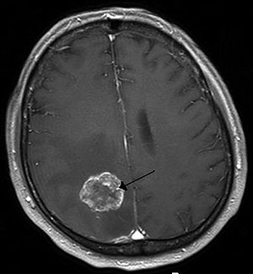
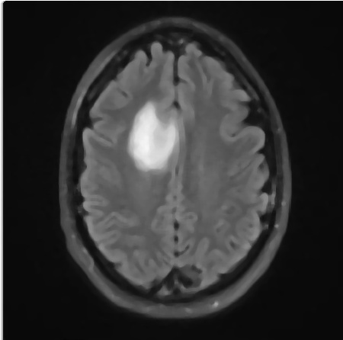
Input (MRI image). & Pre-Processing
We use Dataset MRI images as input
Then Convert these images to Gray Scale Images From Gray Scale We Can apply different process using opencv
First Step is to apply 7X7 median Filter to Remove Noise
Median Filter
Gray Scale
Median Filter

Slide 5
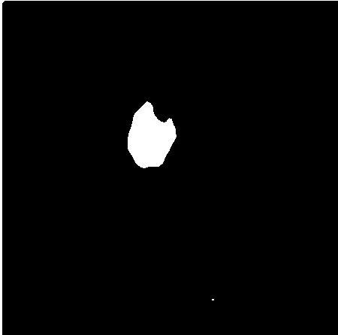
Image Segmentation
We use image segmentation to separate foreground from background and get segmented object, we apply binary threshold.
The Threshold Value = 157.
Threshold
Median Filter
Threshold image

Slide 6

Morphological Operation
Morphological operation is defined in dilation, erosion, opening and closing we use opening and closing to remove small objects and small holes with structure element 3X3
Threshold
Opening
Closing

Slide 7
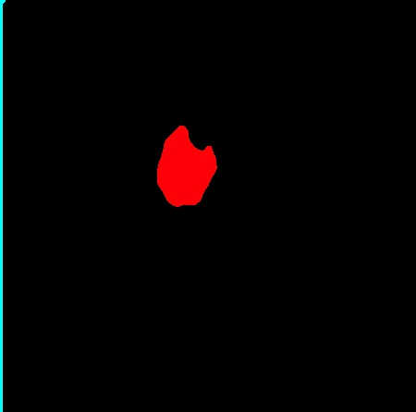
Connected Components
We use blob analysis and connected components to detect objects in image and then we segmented them and classify each image we use 4 connectivity
Connected Components
Closing
Labeled Image

Slide 8


Classification
After detecting blobs in images we can classify images to Normal images and abnormal images, images with one more blob it classify as abnormal, and less than 2 blob it classify as normal image
Classification
Non Tumor
Tumor

Slide 9
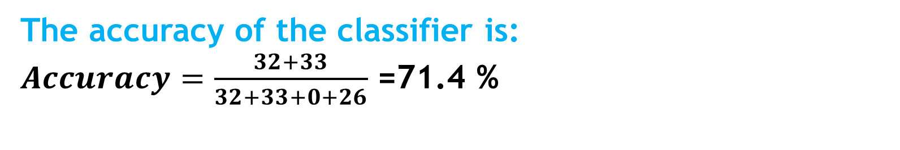
Accuracy
Accuracy from confusion Matrix
 | Tumor | Non-Tumor
 | TN= 33 | FP= 0
 | FN= 26 | TP= 32
The accuracy of the classifier is:
$Accuracy=\frac{32+33}{32+33+0+26}$ =71.4 %

Slide 10
Conclusion
Brain tumor identifications through MRI images is a difficult task because of the complexity of the brain. These tumors can be segmented using various image segmentation techniques. The process of identifying brain tumors through MRI images can be categorized into four different sections; pre-processing which include Median filter which is the most commonly used filtering technique among various filtering techniques, image segmentation, and image classification.

